Slide 1
This house would ban information dissemination on safe injecting practices, and ban the provision of clean and sterile injecting equipment, to intravenous drug users who are minors (15-17 years)
Global Village Debate

Slide 2
YOUNG PEOPLE WHO INJECT DRUGS ASIA-PACIFIC SITUATION

Slide 3
HIV and AIDS among young people (15-24 yr) in Asia and the Pacific 2000-2016
2016 “zoom-in”
90,000
New HIV infections
510,000
Young people living with HIV
6,800
AIDS-related deaths
Young men
Young women
Source: Prepared by www.aidsdatahub.org based on UNAIDS 2017 HIV Estimates

Slide 4
Overview of new HIV infections among young people (15-24) in Asia and the Pacific
Proportion of young people (15-24) in total new HIV infections, 2016
Percent change in new HIV infections among young people, 2010 and 2016
Philippines
136%
increase
Myanmar
25%
decrease
Indonesia
24%
decrease
Thailand
49%
decrease
Lao PDR
40%
decrease
India
17%
decrease
Cambodia
60%
decrease
Regional average
17%
decrease
Papua New Guinea
11%
increase
Afghanistan
68%
increase
Nepal
54%
decrease
Pakistan
25%
increase
Bangladesh
1%
decrease
Viet Nam
43%
decrease
Malaysia
42%
decrease
Australia
1%
increase
Source: Prepared by www.aidsdatahub.org based on UNAIDS 2017 HIV Estimates

Slide 5
HIV prevalence among people who inject drugs by age group, countries where data is available, 2012-2016
Countries with HIV prevalence > 5%
among young people who inject drugs
*Sample size of young PWID from 2014 survey is very small to make comparison with older counterpart
Source: Prepared by www.aidsdatahub.org based on Behavioural Surveys; Integrated Biological and Behavioural Surveys; Global AIDS Response Progress Reporting; Global AIDS Monitoring 2017

Slide 6
Rising HIV prevalence trend among young people who inject drugs, 2010-2014
Source: Prepared by www.aidsdatahub.org based on National HIV/AIDS and STI Surveillance and Strategic Information Unit (2015). The Growing HIV Epidemic among Adolescents in the Philippines; and National AIDS Programme, Department of Health, Ministry of Health, Myanmar and World Health Organization. Results of HIV Sentinel Sero-surveillance 2010 to 2014.

Slide 7
Proportion of PWID with comprehensive HIV knowledge, by age group, countries where data is available, 2007-2016
Proportion of PWID with comprehensive HIV knowledge, by age group, countries where data is available, 2007-2016
* Western to Far Western Terai Highway Districts - male PWID
** male PWID - age group 18-19 yr versus 20+ yr
Source: Prepared by www.aidsdatahub.org based on Behavioural Surveys; Integrated Biological and Behavioural Surveys; UNGASS and Global AIDS Response Progress Reporting

Slide 8
Proportion of PWID reported using sterile injection equipment at last injection by age group, countries where data is available, 2012-2016
* very small sample size (<50) for young PWID; Thailand - very small sample size for young PWID and reported as “data not available”
Source: Prepared by www.aidsdatahub.org based on Behavioural Surveys; Integrated Biological and Behavioural Surveys; Global AIDS Response Progress Reporting; Global AIDS Monitoring 2017
Notes:
What we do not know from these data is how granular it is to highlight access among 15-17, given that many countries in the region are not allowed to provide any form of medical service independently without any form of consent

Slide 9
Snapshot of harm reduction in Asia and the Pacific, 2016
 | Needle and syringe programmes operational | Needle and syringe programmes coverage | Possession of needle and syringe used as evidence for arrest | Opioid substitution therapy programmes operational | Opioid substitution therapy programmes coverage | Naloxone available through community distribution
Afghanistan | Yes |  | NO INFO | Yes |  | No
Australia | Yes |  | NO INFO | Yes |  | NO INFO
Bangladesh* | Yes |  | No | Yes |  | No
Cambodia | Yes |  | No | Yes |  | Yes
China | Yes |  | No | Yes |  | Yes
India | Yes |  | No | Yes |  | Yes
Indonesia | Yes |  | NO INFO | Yes |  | NO INFO
Lao PDR | Yes |  | No | No |  | No
Malaysia | Yes |  | No | Yes |  | Yes
Myanmar | Yes |  | No | Yes |  | No
Nepal | Yes |  | Yes | Yes |  | No
New Zealand | Yes |  | No | Yes |  | No
Pakistan | Yes |  | Yes | No |  | No
Philippines | No |  | Yes | No |  | No
Sri Lanka | No |  | No | No |  | No
Thailand | Yes |  | Yes | Yes |  | Yes
Viet Nam | Yes |  | NO INFO | Yes |  | NO INFO
Countries with HIV prevalence among PWID ≥ 5%
NSP programme coverage
(syringes per PWID per year)
High coverage: >200
Medium coverage: >100–<200
Low coverage: <100
No service
No info/ not reported
OST programme coverage
(% opioid injectors on OST)
High coverage: >40%
Medium coverage: 20 – ≤ 40%
Low coverage: < 20%
No service
No info/ not reported
Source: Prepared by www.aidsdatahub.org based on Global AIDS Monitoring (GAM) reporting
* HIV prevalence from 2 sentinel sites - Dhaka and Hili

Slide 10
Punitive laws hindering HIV responses among PWID in Southeast Asia
 |  | Compulsory detention centres for people who use drugs |  | Death penalty for drug-related offences
Brunei |  | YES |  | YES
Cambodia |  | YES |  | NO
Indonesia |  | YES |  | YES
Lao PDR |  | YES |  | YES
Malaysia |  | YES |  | YES
Myanmar |  | YES |  | YES
Philippines |  | YES |  | YES
Singapore |  | YES |  | YES
Thailand |  | YES |  | YES
Timor-Leste |  | NO |  | NO
Viet Nam |  | YES |  | YES
Source: Prepared by www.aidsdatahub.org based on UNAIDS, UNDP, UNFPA, and UNODC. (2014). Punitive Laws Hindering the HIV Response in Asia and the Pacific in October 2014

Slide 11
This house would ban information dissemination on safe injecting practices, and ban the provision of clean and sterile injecting equipment, to intravenous drug users who are minors (15-17 years)
The proposition

Slide 12
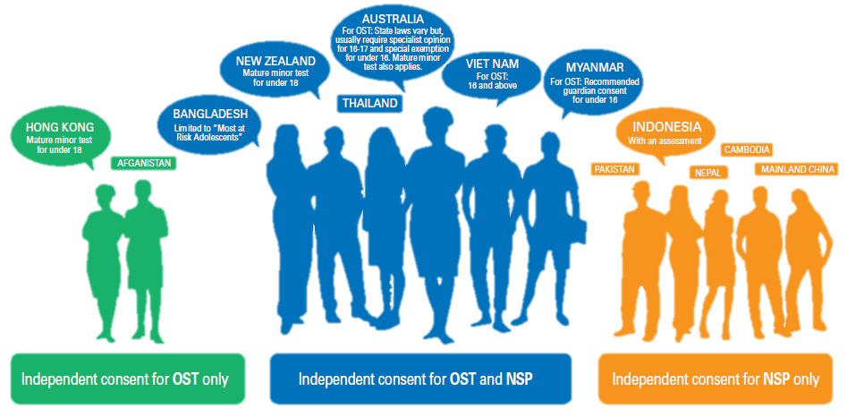
Countries enabling independent consent for young people to access harm reduction services, Asia Pacific
Source: UNICEF, UNESCO, UNFPA, UNODC, Youth LEAD, & Youth Voices Count. (2015). Adolescents Under the Radar in the Asia-Pacific AIDS Response.
Notes:
But we do not know whether these have really increased access among young PWID or not

